Slide 1
Software Development Life cycle
Models

Slide 2
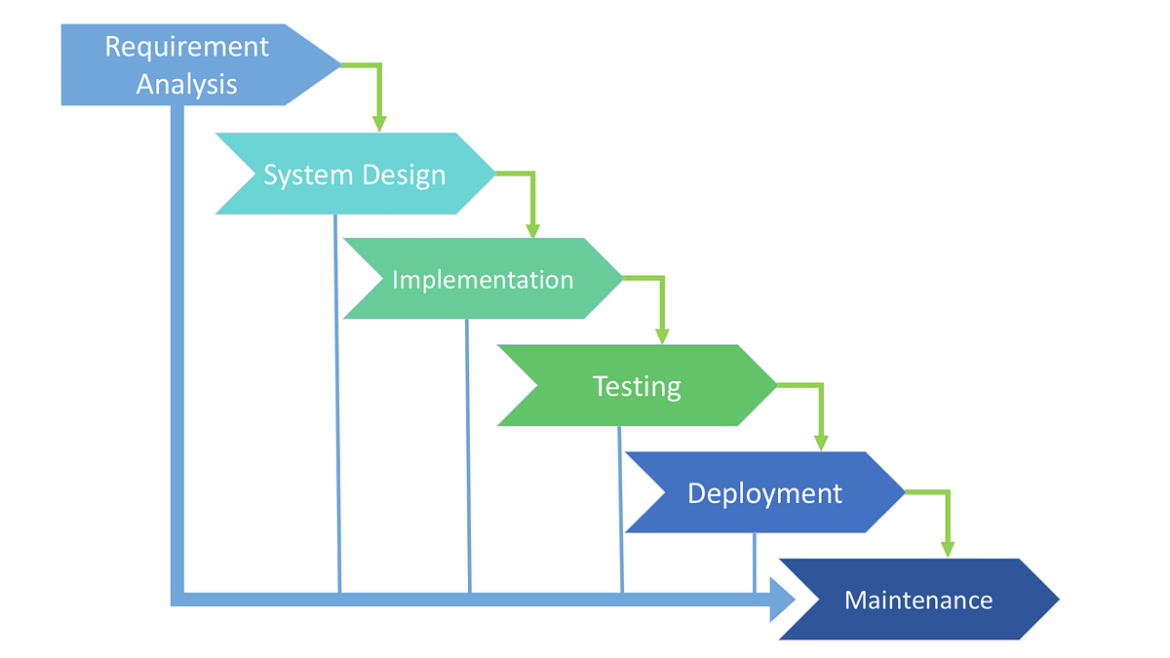
Waterfall Model
The Waterfall Model is a traditional software development methodology that follows a linear and sequential approach, where development progresses through a series of distinct phases, with each phase dependent on the deliverables of the previous phase.
Phases in waterfall model :
Requirements: In the Requirements phase, the project requirements are gathered and documented in detail. This phase involves understanding the needs of the stakeholders and defining the scope of the project.
Design: Once the requirements are finalized, the Design phase begins. In this phase, the system architecture and detailed design specifications are developed based on the requirements gathered. This includes designing the software architecture, data models, user interfaces, and system components.
Implementation: The Implementation phase involves the actual coding or development of the software based on the design specifications. Programmers write code, develop algorithms, and integrate different components to create the software solution.
Testing: After the software is developed, it undergoes testing in the Testing phase. This phase involves various types of testing, including unit testing, integration testing, system testing, and user acceptance testing (UAT). The goal is to identify and fix defects or bugs before releasing the software to production.
Deployment: Once the software has been thoroughly tested and approved, it is deployed or released to the end-users in the Deployment phase. This involves installing the software, configuring it for use, and providing training and support to users as needed.
Maintenance: The final phase of the Waterfall Model is Maintenance, where the software is maintained and supported throughout its lifecycle. This includes fixing bugs, addressing user feedback, making updates or enhancements, and ensuring the ongoing reliability and performance of the software.

Slide 3
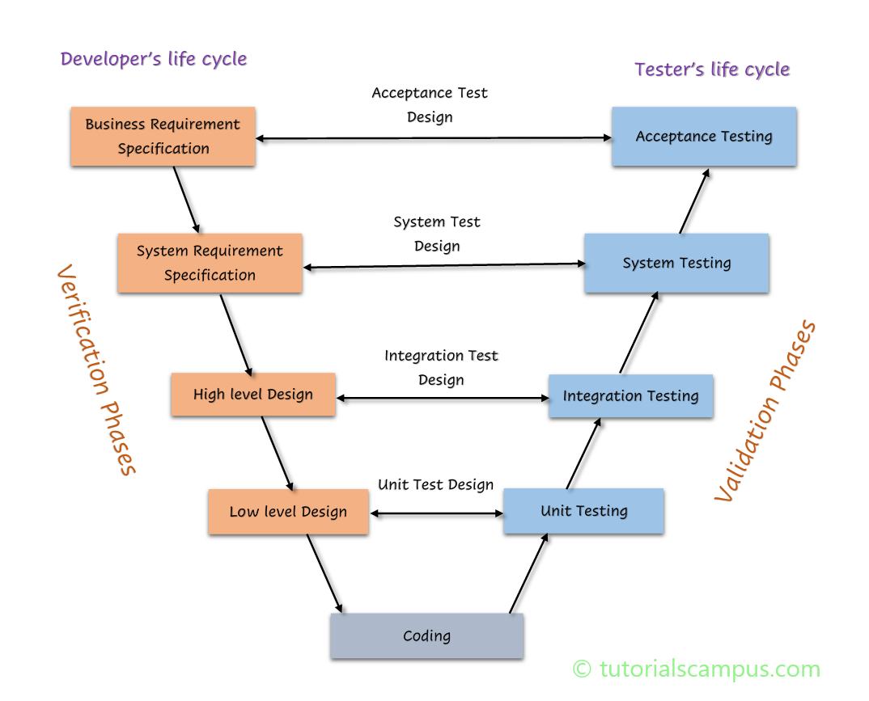
V Model
The V-Model, also known as the Verification and Validation Model, is a software development and testing methodology that emphasizes the relationship between each phase of development and its corresponding testing phase. It is an extension of the traditional Waterfall Model and provides a structured approach to software development and testing. The V-Model is so named because of its V-shaped diagram, which illustrates the relationship between development phases and testing phases. Here's an overview of the V-Model along with a simple diagram:
Phases
Requirements Analysis: Similar to the Waterfall Model, the V-Model begins with the Requirements Analysis phase, where project requirements are gathered, analyzed, and documented in detail.
System Design: Once the requirements are finalized, the System Design phase begins. In this phase, the overall system architecture and high-level design specifications are developed based on the requirements.
Subsystem Design (Low-Level Design): Following the System Design phase, the Subsystem Design phase focuses on the detailed design of individual subsystems or components. Low-level design specifications are created, specifying the internal workings and interactions of each subsystem.
Implementation: The Implementation phase involves the actual coding or development of the software based on the design specifications. Programmers write code, develop algorithms, and integrate different components to create the software solution.
Unit Testing: As each subsystem or component is implemented, it undergoes Unit Testing. Unit tests are conducted to verify the functionality and behavior of individual units of code in isolation.
Integration Testing: Once all subsystems or components are developed and unit tested, Integration Testing is performed to verify the interactions and interfaces between these components. The integrated system is tested as a whole to ensure that it functions correctly as a unified whole.
System Testing: After integration testing, the entire system undergoes System Testing. System tests are conducted to validate the system against the original requirements and verify that it meets the specified functional and non-functional requirements.
Acceptance Testing: The final phase of the V-Model is Acceptance Testing. This phase involves validating the software against user acceptance criteria and obtaining approval from stakeholders before deployment.

Slide 4
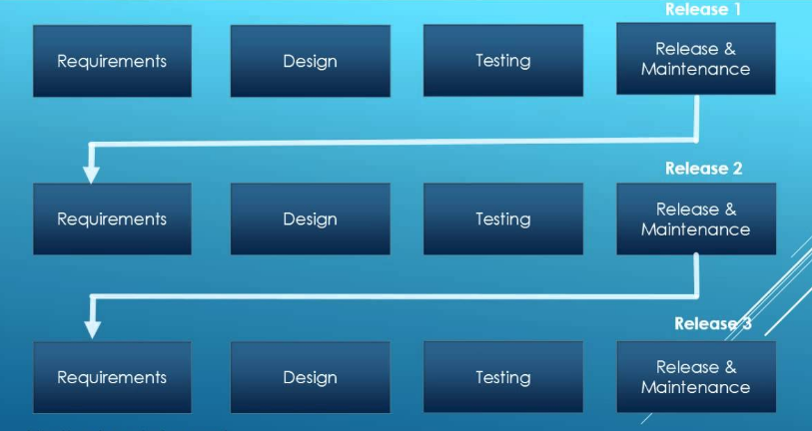
Iterative Model
The Iterative Model is a software development methodology that involves breaking down the software development process into smaller, repeatable cycles called iterations. Each iteration follows a mini-waterfall model, where requirements are analyzed, designed, implemented, and tested within a relatively short time frame. The Iterative Model allows for flexibility, adaptability, and incremental development, enabling continuous feedback and improvement throughout the development lifecycle. Here's an overview of the Iterative Model:
Planning: The development team and stakeholders collaborate to define the overall project goals, scope, and priorities. The project is divided into iterations, with each iteration focusing on delivering a specific set of features or functionality.
Iteration Planning: At the beginning of each iteration, the team selects a subset of requirements from the overall backlog to be implemented and tested during the iteration. The requirements are analyzed, prioritized, and estimated for effort.
Requirements Analysis: The selected requirements are further analyzed and refined to ensure a clear understanding of the user needs and acceptance criteria. Any ambiguities or uncertainties are addressed before proceeding to design and implementation.
Design: Based on the refined requirements, the design phase begins, where the system architecture, interfaces, and components are designed. The design is kept flexible to accommodate changes and additions in subsequent iterations.
Implementation: The development team implements the designed features or functionality according to the specifications defined in the iteration. Coding standards, best practices, and version control are used to ensure code quality and maintainability.
Testing: Once the implementation is complete, the software undergoes testing in the Testing phase. Testing activities include unit testing, integration testing, system testing, and user acceptance testing (UAT). Test cases are executed to validate the functionality and identify any defects or issues.
Review and Feedback: At the end of each iteration, a review session is conducted to assess the progress, quality, and outcomes of the iteration. Stakeholders provide feedback on the implemented features, which informs future iterations and adjustments to the project plan.
Incremental Delivery: After testing and review, the completed features are delivered to the stakeholders for evaluation and feedback. Incremental delivery allows stakeholders to see tangible progress and provide early feedback, which can influence subsequent iterations.
Iteration Retrospective: Following the review session, the team conducts a retrospective to reflect on the iteration's successes, challenges, and lessons learned. The retrospective helps identify areas for improvement and informs adjustments to the development process for future iterations.
Repeat: The development process iterates through successive cycles, with each iteration building upon the work of previous iterations. Requirements are refined, implemented, tested, and delivered incrementally until the project goals are achieved.

Slide 5
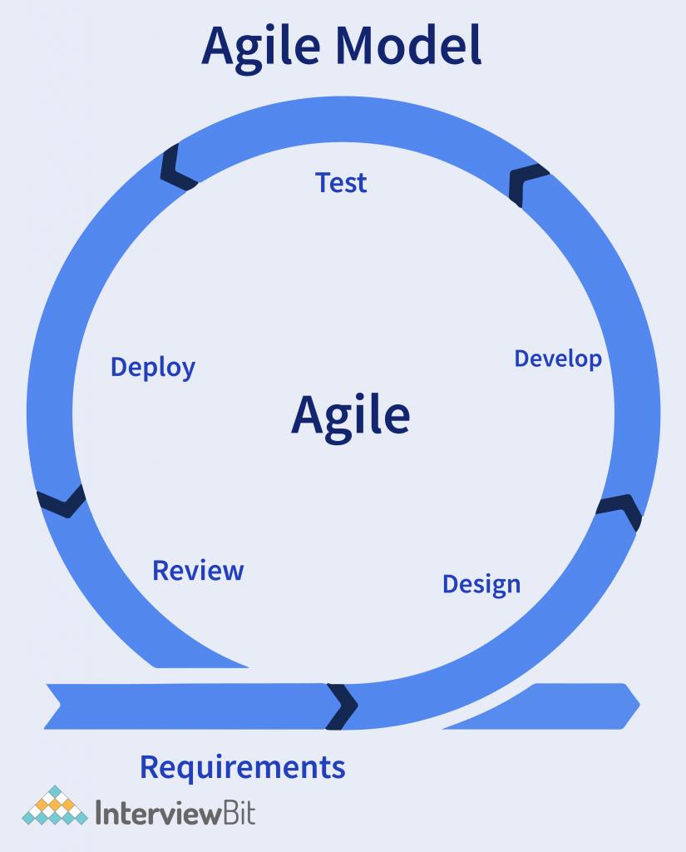
Agile Model
The Agile Model is a software development methodology that emphasizes flexibility, collaboration, and customer satisfaction through iterative and incremental delivery of software solutions. It prioritizes responding to change over following a rigid plan and promotes adaptive planning, evolutionary development, and early delivery. The Agile Model is based on the Agile Manifesto and its twelve principles, which prioritize individuals and interactions, working software, customer collaboration, and responding to change. Here's an overview of the Agile Model:
Iterative and Incremental Development: The Agile Model divides the software development process into small, manageable iterations or increments, typically lasting one to four weeks. Each iteration results in a potentially shippable product increment, allowing for continuous delivery of value to the customer.
Customer Collaboration: Agile prioritizes close collaboration between the development team and the customer or stakeholders throughout the development process. Customer involvement is encouraged through regular feedback sessions, demonstrations, and reviews to ensure that the software meets their needs and expectations.
Adaptive Planning: Agile planning is adaptive and flexible, allowing for changes in requirements, priorities, and scope as the project progresses. Instead of detailed upfront planning, Agile teams focus on high-level goals and adapt their plans based on feedback and changing circumstances.
Cross-Functional Teams: Agile teams are typically cross-functional, comprising members with diverse skills and expertise, including developers, testers, designers, and product owners. Cross-functional teams collaborate closely to deliver integrated solutions and address both technical and business aspects of the project.
Continuous Improvement: Agile promotes a culture of continuous improvement, where teams reflect on their processes, practices, and outcomes at regular intervals. Retrospectives are conducted after each iteration to identify areas for improvement and implement changes to enhance team performance and product quality.
Transparent Communication: Agile emphasizes open and transparent communication within the team and with stakeholders. Daily stand-up meetings, regular progress updates, and frequent interactions facilitate shared understanding, alignment, and collaboration.
Emphasis on Working Software: The primary measure of progress in Agile is the delivery of working software. Agile teams prioritize delivering value to the customer by focusing on producing functional, usable software increments at the end of each iteration.
Feedback-Driven Development: Agile development is driven by feedback from stakeholders, end-users, and the market. Early and frequent feedback loops enable teams to validate assumptions, identify issues, and make informed decisions to guide development efforts.
Embracing Change: Agile embraces change as a natural and inevitable part of the development process. Instead of resisting change, Agile teams welcome it as an opportunity to adapt, learn, and deliver greater value to the customer.
Empirical Process Control: Agile relies on empirical process control, where decisions are based on observation, experimentation, and feedback rather than rigid adherence to predefined plans or processes. Agile teams continuously inspect and adapt their processes to optimize outcomes and achieve project goals.

